Slide 1
An Introduction to GLM Theory
19 June 2018

Slide 2
Goals of Modeling
Understanding the relationships between variables
Estimating unknown parameters.
Predicting the value of one variable, given a set of known predictor values.

Slide 3
Definitions
Y = Response Variable
aka Target Variable, Dependent Variable
X₁, X₂, … = Predictor Variables
aka Explanatory Variable, Independent Variable
Factor – a categorical predictor
Dummy variable – an indicator to represent the presence/absence of a categorical variable
Covariate / Variate – a continuous predictor
Covariate Profile
Notes:
Factors are represented by dummy variables. Need to make category numeric for fitting in model.

Slide 4

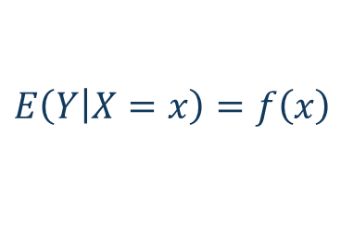

Understanding Dependence
Scatterplots
Correlation $(r=−0.7452)$
Mean functions
$$E\left(\left.Y\right|X=x\right)=f\left(x\right)$$
$$=2.32−1.86x$$

Slide 5
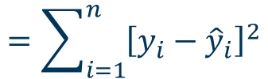

Ordinary Least Squares
Minimize the total squared error
$$\sum_{i=1}^{n}{{\left[y_{i}−\left(β_{0}−β_{1}x_{i}\right)\right]}^{2}}$$
$$=\sum_{i=1}^{n}{{\left[y_{i}−{\hat{y}}_{i}\right]}^{2}}$$

Slide 6







What kind of models are linear?
Generic Linear Model:
Examples:
$$y=β_{0}+β_{1}x_{1}+⋯+β_{p}x_{p}$$
$$=x_{i}^{T}β$$
$y=β_{0}+β_{1}x+β_{2}x^{2}$
$$y=β_{0}β_{1}^{x_{1}}β_{2}^{x_{2}}$$
$$⇒\ln\left(y\right)=\ln{β_{0}}+x_{1}\ln{β_{1}}+\ln{β_{2}}$$
$$y=β_{1}\exp\left(β_{2}x\right)+β_{3}exp⁡(β_{4})$$
$$⇒not linear$$
$$\ln\left(Pure Premium\right)=base+β_{1}CovA+β_{2}Deductible+β_{3}Tier+⋯$$
Notes:
Emphasize that dummy variables will be used for factors.

Slide 7
Ordinary Least Squares
Advantages:
Only one assumption – The mean model has a known linear form.
Solve for parameters using calculus methods
Simple, closed form solution
Disadvantages:
A mathematical method, not a statistical method
Can’t make inferences without a probability assumption

Slide 8
Normal Distribution

Slide 9





Binomial Proportion
$$X=\frac{0}{n},\frac{1}{n},⋯,1$$
$$n=Number of trials$$
$$π=P(Success)$$
$$E\left(X\right)=π$$
$$var\left(X\right)=\frac{π(1−π)}{n}$$

Slide 10



Poisson Distribution
$$X=0, 1, 2, …$$
$$E\left(X\right)=λ$$
$$var\left(X\right)=λ$$

Slide 11
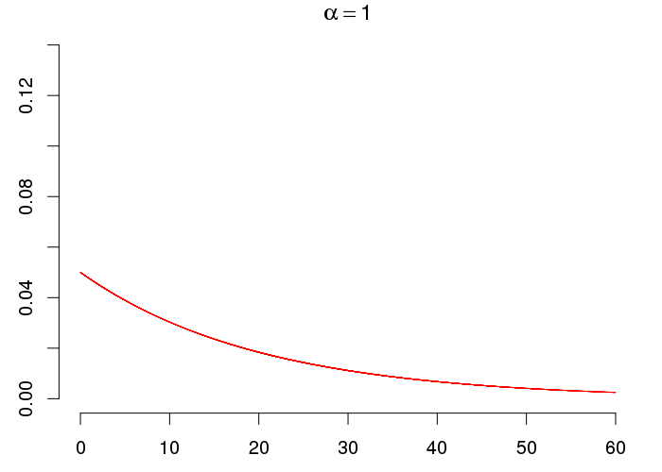
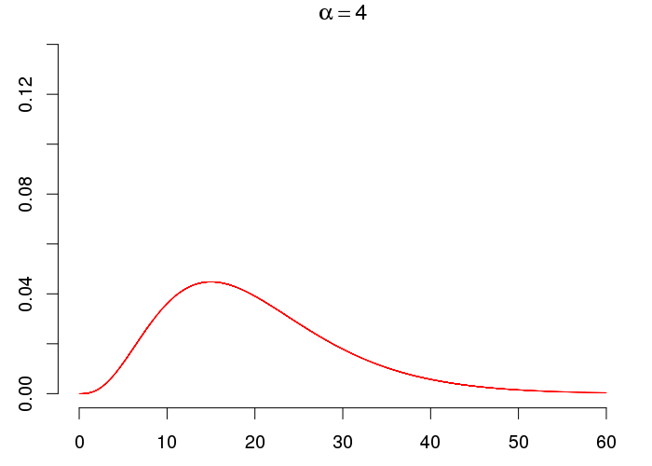
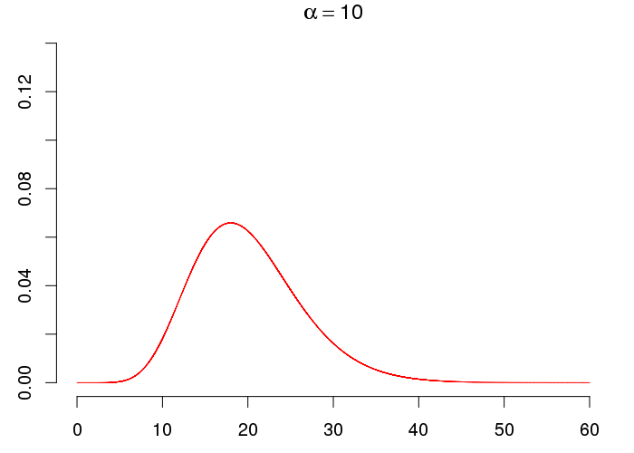
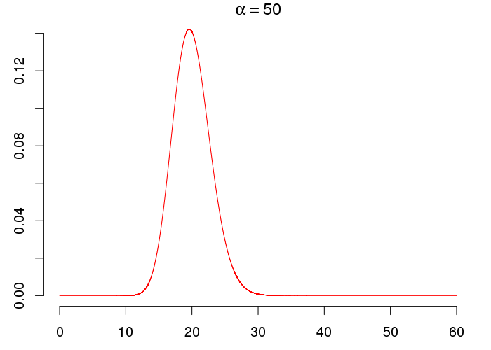
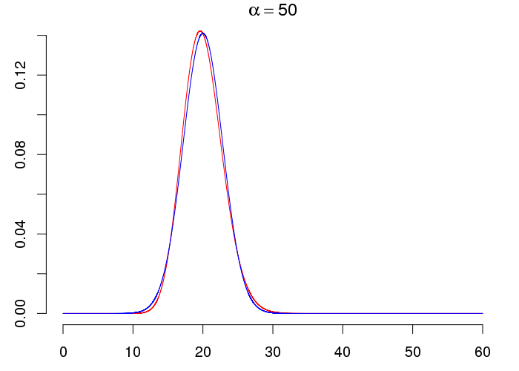





Gamma Distribution
$$0≤X<∞$$
$$α=Shape Parameter$$
$$E\left(X\right)=αβ$$
$$β=Scale Parmeter$$
$$var\left(X\right)=αβ^{2}$$

Slide 12




Normal Linear Model
Assumptions:
$$y_{i}←Y_{i} indep∼N\left(μ_{i}, σ^{2}\right)$$
$$μ_{i}=x_{i}^{T}β$$
Alternate specification:
$$y_{i}←Y_{i}=x_{i}^{T}β+E_{i}$$
$$E_{i} indep∼N\left(0, σ^{2}\right)$$
Notes:
Assumptions:
• Linearity
• Independence
• Homoscedasticity
• Normality

Slide 13
Normal Linear Model – Solving for coefficients
Maximum Likelihood Estimate (MLE)
Select parameter values that are “most likely” to produce the observed data
Least Squares Estimate (LSE)
Under the normality assumption, LSE = MLE
Even without normality, LSE has the lowest variance among all possible linear unbiased estimators.
Notes:
Properties of maximum likelihood estimators:
• Consistent – MLE converges in probability to the value being estimated
• Asymptotically Normal – as the sample size increases, the distribution of the MLE tends to normal with covariance matrix equal to the inverse of the Fisher information matrix.
• Efficient – achieves Cramer-Rao lower bound when sample size tends to infinity
Gauss- Markov theorem assumptions:
• errors are homoscedastic
• errors are uncorrelated
• Normality, independence, identically distributed – not needed

Slide 14


Generalized Linear Model
Assumptions
Exponential Family
Link function
Linear predictor
$$y_{i}←Y_{i} indep∼EF\left(μ_{i}, φ\right)$$
$${g(μ}_{i})=x_{i}^{T}β$$
Notes:
Coefficient estimates are maximum likelihood estimates
Problem = can’t use Least Squares

Slide 15
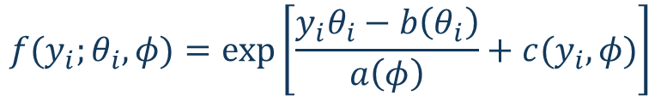
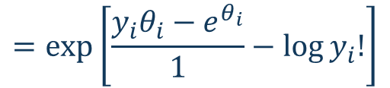

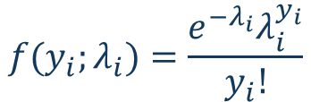
GLM: Exponential Family
$$f(y_{i};θ_{i},φ)=exp\left[\frac{y_{i}θ_{i}−b\left(θ_{i}\right)}{a\left(φ\right)}+c(y_{i},φ)\right]$$
Examples:
Normal
Gamma
Poisson
Binomial
$$f(y_{i};λ_{i})=\frac{e^{−λ_{i}}λ_{i}^{y_{i}}}{y_{i}!}$$
$$=exp⁡\left[y_{i}\log{λ_{i}}−λ_{i}−log⁡y_{i}!\right]$$
$$=exp⁡\left[\frac{y_{i}θ_{i}−e^{θ_{i}}}{1}−log⁡y_{i}!\right]$$
Notes:
φ = scale (dispersion) parameter
μ = b'(θ)
var(Y) = b''(θ)a(φ)
θ = the natural parameter [a function of the mean, c(μ)]
The canonical link transforms the mean to the natural parameter [c is the canonical link function]

Slide 16
GLM: Link function
Required Properties:
Monotonic
Differentiable
Choosing a link:
No need to stabilize variance or produce normality
Canonical link – some computational advantages
Choose the link that’s useful for your model

Slide 17
Why GLMs?
Maximum Likelihood Estimates
A single algorithm can be used for any GLM
Iterative re-weighted least squares
Avoid transforming Y
Transformations to correct both non-normality and heteroscedasticity are hard to find.

Slide 18
Using GLM on insurance data
Frequency Models
Exponential family = Poisson
Link Function = log
Severity Models
Exponential family = Gamma
Link Function = log
Pure Premium Models
Exponential family = Tweedie
Link Function = log
Notes:
Tweedie is appropriate for modeling raw pure premium, not appropriate for modeling modeled pure premium.
Use gamma to model modeled pure premium.

Slide 19

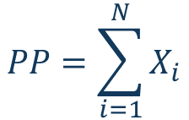

Tweedie Distribution
A Compound Gamma-Poisson Process
$$PP=\sum_{i=1}^{N}{X_{i}}$$
$$X_{i}∼Gamma$$
$$N∼Poisson$$
Tweedie parameters (μ, φ, p ) are determined by parameters of underlying Poisson and Gamma distributions
p = the index parameter
As p → 1, Tweedie approaches over-dispersed Poisson
As p → 2, Tweedie approaches Gamma
Notes:
μ = λ × α × β
p = (α + 2) / (α + 1)
φ = [λ^(1-p) × (αβ)^(2-p)] / (2-p)

Slide 20
What does a Tweedie density look like?
Notes:
Note probability mass at 0 for p < 2

Slide 21

Further Generalizations of the GLM
Quasi-Likelihood
Drop the distributional assumption
Assume only that
Generalized Additive Model
Replaces the linear predictor with a smooth function of the predictors
$$var(Y_{i})=v(μ_{i})$$

Slide 22


Slide 23







Appendix: Exponential Family
$$f(y_{i};θ_{i},φ)=exp\left[\frac{y_{i}θ_{i}−b\left(θ_{i}\right)}{a\left(φ\right)}+c(y_{i},φ)\right]$$
$φ=$ dispersion (scale) parameter
$$E\left(Y\right)=b′(θ)$$
$θ=$ The natural parameter
$$var\left(Y\right)=b^{′′}\left(θ\right)a(φ)$$
= A function of $E(Y)$
Canonical link = the function that transforms $E(Y)$ to the natural parameter
Notes:
φ = scale (dispersion) parameter
μ = b'(θ)
var(Y) = b''(θ)a(φ)
θ = the natural parameter [a function of the mean, c(μ)]
The canonical link transforms the mean to the natural parameter [c is the canonical link function]

Slide 24
Bernoulli Distribution

Slide 25
Binomial Proportion Distribution

Slide 26
Poisson Distribution

Slide 27
Gamma Distribution

Slide 28
Normal Distribution

